Slide 1
Simple table formats
Pre-formatted, minimal tables to copy into your documents

Slide 2
How to use these tables
How to copy a table
  Select the whole table. Either click on the edge or click inside and press Ctrl+A/Cmd+A.
  Ctrl+C/Cmd+C to copy to the clipboard.
How to paste into your deck
  In your document select the target slide. If the slide has a particular placeholder you wish to use, select that next.
  Ctrl+V/Cmd+V to paste.
  Adjust the text size as appropriate to your content. You may find it easier to do this after you have filled the table.
How to adjust for your content
  Simply add or delete rows and/or columns.
  If you have existing table content you will find that trying to paste it into the new blank table is likely to overwrite the formatting. There is no easy way around this. We recommend using the BrightSlide add-in to copy the format from the new table to the old one instead.
  Common pasting issues
The colours are odd
  The tables are set using Accent 1 for the heading font colour and the total row border, then Accent 2 for the header row border. So they will use the corresponding colours in your template – but these might not be the best choices in your palette. You’ll have to update them to something else..
It has kept the same fonts and colours from this document
  By default, PowerPoint usually pastes using the destination format. If that doesn’t happen, straight after pasting click the little clipboard icons that appears by the table and select ‘Use destination theme’.
  If that doesn’t work, it usually means there is an issue in how your template has been configured.
I want the table to fit into the placeholder
  If you have pasted into a placeholder, you will probably find that the table keeps its original width. To force the table to fit the placeholder: Home tab > Layouts > reselect the existing layout.
  You may of course then need to adjust column widths accordingly.
Notes on the tables
There are two simple tables included. The first is a more standard, horizontal layout. Use this where each row is an ‘item’. Alternatively, if the main grouping is by column, use the second table.
The tables are created with 12pt text. That is not mean to be a recommendation; choose a font size that works best in the context of your deck.
Alternative tables are provided with a format applied for the last row or column.
Step-by-step instructions on formatting tables from scratch are provided at the end of this document, along with suggested format parameters.

Slide 3
Tables for copying
Header | Header | Header | Header
Text | Text | Text | Text
Text | Text | Text | Text
Text | Text | Text | Text
Text | Text | Text | Text
Text | Text | Text | Text
Header | Text | Text | Text | Text
Header | Text | Text | Text | Text
Header | Text | Text | Text | Text
Header | Text | Text | Text | Text
Header | Text | Text | Text | Text
Header | Text | Text | Text | Text
Header | Header | Header | Header
Text | Text | Text | Text
Text | Text | Text | Text
Text | Text | Text | Text
Text | Text | Text | Text
Total | Total | Total | Total
Header | Text | Text | Text | Summary
Header | Text | Text | Text | Summary
Header | Text | Text | Text | Summary
Header | Text | Text | Text | Summary
Header | Text | Text | Text | Summary
Header | Text | Text | Text | Summary

Slide 4
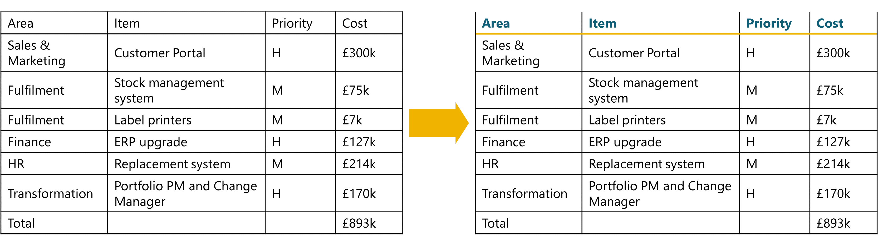
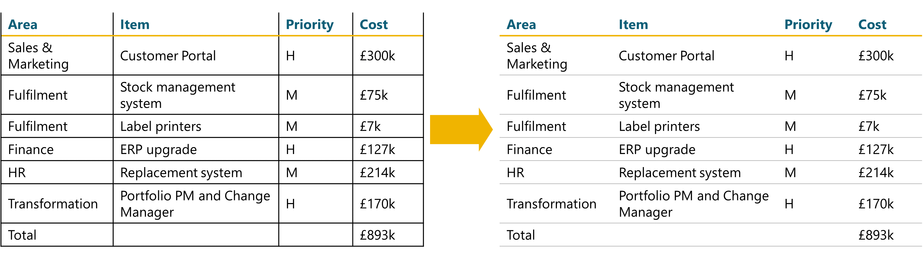
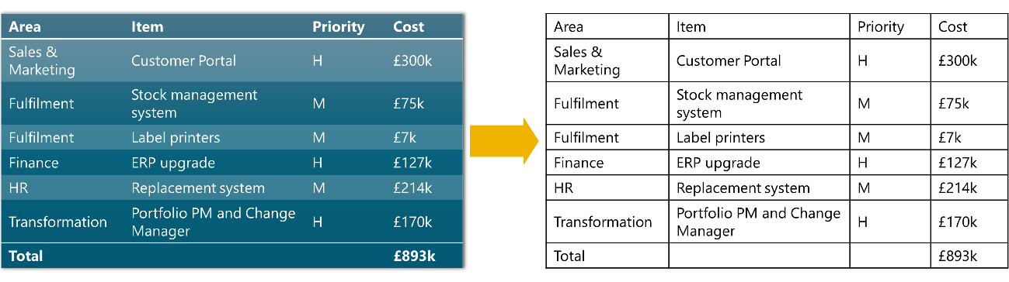
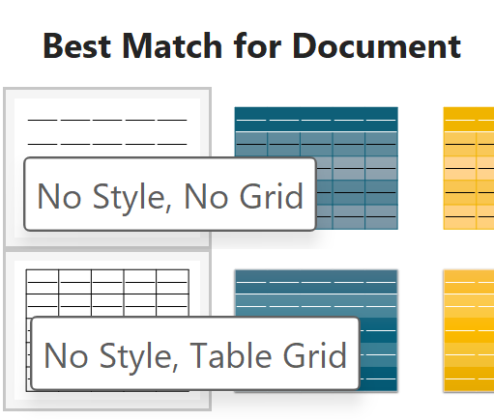
Step-by-step guide to better formatted tables (1 of 2)
Note: we haven’t included recommendations for font size, as that depends on your content. However, we do recommend using a consistent size throughout your document, and it probably needs to be a couple of sizes smaller than your default text size.
Clear out the default formatting
Depending on your template, your default table format could have all sorts of table borders, fill and font formatting. You could either go through and remove each of those in turn, but we recommend applying one of the built-in table styles.
Go to the Table Design tab, and in the Table Styles dropdown you can choose either:
2. Format header row
This is our go-to format for the column headers:
  Make the text bold. Optionally, add a font colour using one of your accent colours (as long as it has enough contrast against the background). Or use all-caps.
  Add a border below using 1½pt or 2¼pt thickness and in one of the key accent colours.
  Turn the top border off. The quickest way to do this is to select the top border button to turn the border on and then click it again to turn it off.
3. Add row borders
Our standard format for rows:
  Thickness ¾pt
  Colour: mid-grey. Either the middle of the 5 shades under white (Darker 25%) or a suitable neutral pallet colour.
  Turn all column borders off - left, right and inside.
You should now be left with just horizontal gridlines
  No Style, No Grid - this clears out everything but is harder to use in practice because you can’t see where the rows and columns are while you are formatting it.
  No Style, Table Grid - this clears everything but leaves a simple black cell border for the whole table. This option is easier because you can easily see where the rows and columns are. You just have to remove any unwanted borders in Step 3.

Slide 5
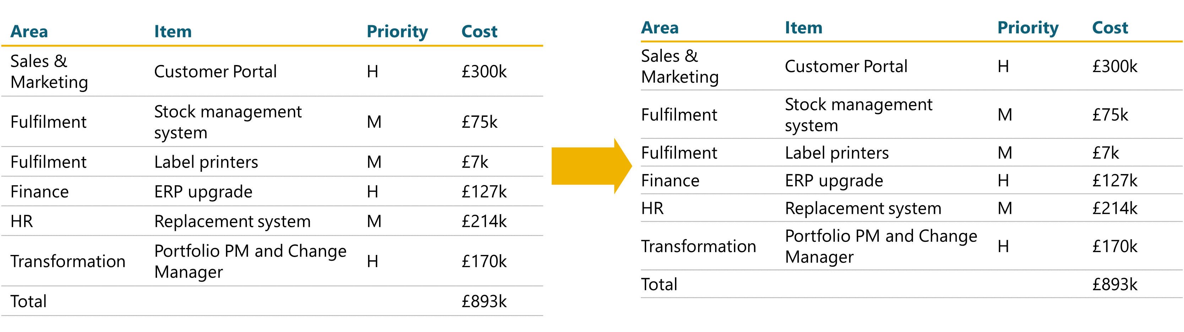
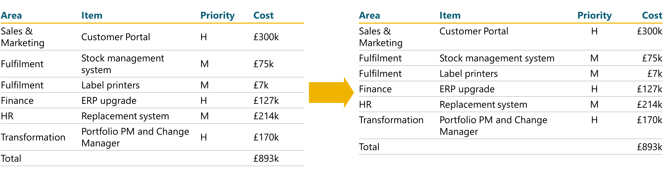
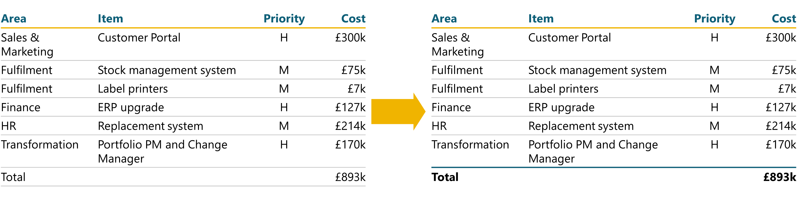
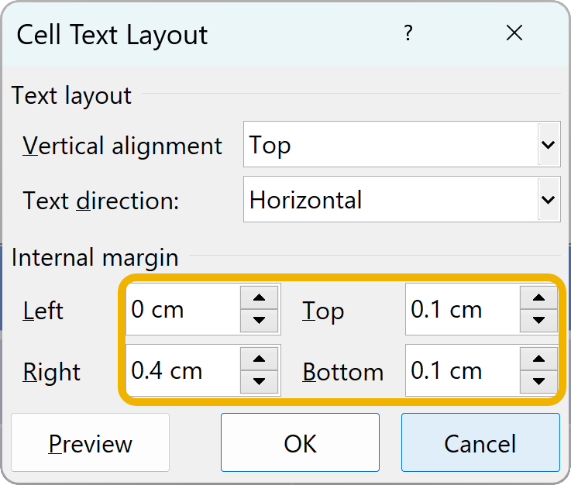
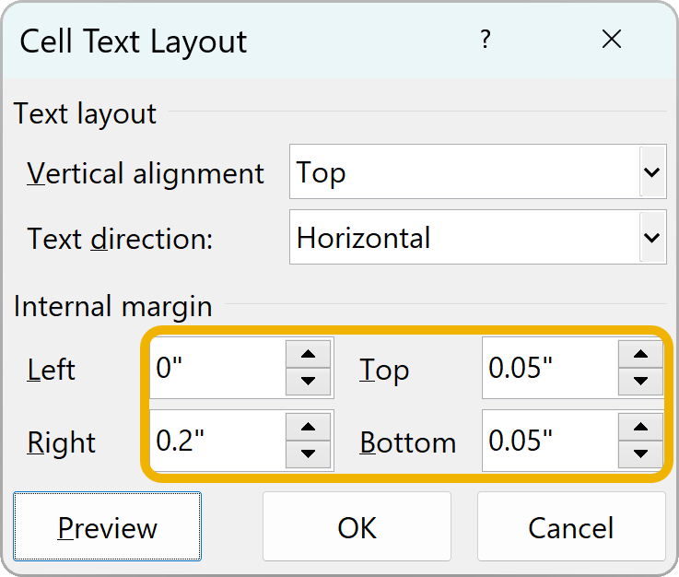
Step-by-step guide to better formatted tables (2 of 2)
4. Adjust the margins
  Select the whole table. Table Layout > Cell Margins > Custom Margins
  Set the custom margins as follows:
Optionally, if you want to you can also:
  Select the last column and set the right margin to zero (since there is nothing for it to run into).
  Select the header row and set the top margin to zero
5. Text alignment
Different types of content work best with different text alignments. So go through each column and change the alignment if appropriate:
  Left-align: General text: sentences, short phrases, full names
  Centre-align: Short fields: dates, Y/N, RAG status, initials, short labels/tags, simple numbers (no more than two digits)
  Right-align: long numbers, and any financial figures
For rows, it’s generally easier for readers to top-align all the content.
6. Format the bottom row (if relevant)
If the bottom row contains totals or summary information, you need to make it clear that it is different from the rows above. We suggest the following:
  Borders: a top border of the same thickness as the header row. You could use the same colour, or you could use a different accent colour or just black or dark grey. You could also add an identical bottom border.
  Text: make the text bold, and potentially use a different colour from the header row text. We usually keep the font size the same.

Slide 6
Get your point across
When you’ve got a
complex topic to explain,
we will make it easy to understand.
And hard to forget.

